Slide 1
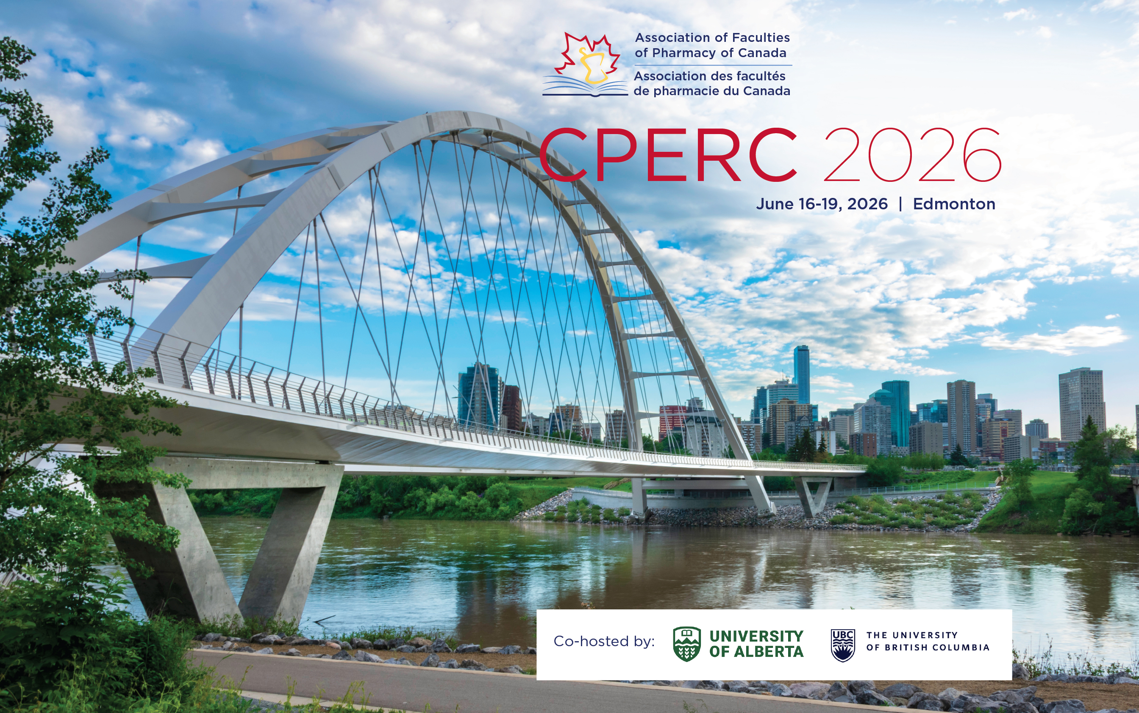
1st SIG SUMMIT
June 18 – Edmonton

Slide 2
AGENDA
Opening Remarks / Introductions
SIG Presentations & Discussions
2nd SIG Summit

Slide 3
OBJECTIVES
Share the objectives and achievements of the SIGs to a wide audience
Foster collaborations across SIGs
Inform on the deliverables to expect from SIGs

Slide 4
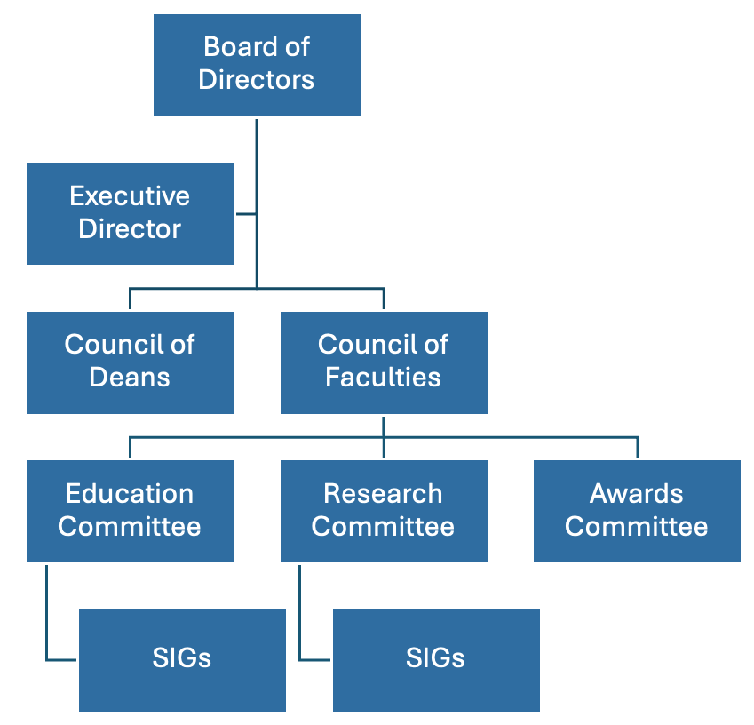

Slide 5
2024 SIGs
Program Evaluation
Educational Assessment
Geriatrics
e-Resources
Medicinal Chemistry
PEP-C
Planetary Health
Self-Care Therapeutics & Minor Ailments
Skills Labs
Truth & Reconciliation
Substance Use & Health

Slide 6
2025 Additions 2026 Additions
Infectious Diseases
Leadership development
Pharmacy Practice Graduate Education
Professional Identity
Pharmacy Practice Research?
Social Health?

Slide 7
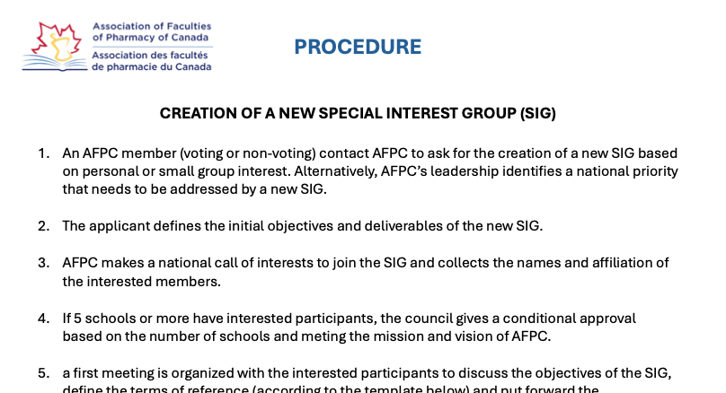
SIG Creation Procedure
https://www.afpcpharmacy.ca/sigs

Slide 8
AGENDA
Opening Remarks / Introductions
SIG Presentations & Discussions
2nd SIG Summit

Slide 9
PROGRAM EVALUATION SIG
Certina Ho
  University of Toronto
Brianna Groot
  University of Saskatchewan
  The Program Evaluation SIG is responsible to promote scholarship and collaboration in program evaluation and ongoing improvement efforts across the Schools of Pharmacy in Canada.
  For the purposes of clarity across Terms of Reference, the term assessment refers to evaluation of persons’ performance (e.g., students’) and the term evaluation refers to evaluation of programs’ performance

Slide 10
EDUCATIONAL ASSESSMENT SIG
George Pachev
  University of British Columbia
Robert Renaud
  - University of Manitoba
  The Educational Assessment SIG is responsible to promote scholarship and collaboration in educational assessment efforts across the Schools of Pharmacy in Canada.

Slide 11
PROGRAM EVALUATION + EDUCATIONAL ASSESSMENT SIG
“Standing” collaboration between the Program Evaluation and the Educational Assessment SIGs
Projects nearing completion
  AI in Educational Assessment
  Program Evaluation Guide
  CPERC concurrent session: Ensuring achievement of education outcomes
    Was June 17 (Wed) 3:30-4:30 (Devonian Room)
  New and ongoing projects:
    Graduation / Exit Survey
    Conception of Readiness
    Journal Club

Slide 12
EDUCATIONAL ASSESSMENT SIG
Ongoing projects and collaborations
  Graduating students survey
New projects and collaborations
  Conceptions of readiness

Slide 13
GERIATRICS SIG
Shanna Trenaman
  Dalhousie University
Louise Papillon-Ferland
  Université de Montréal

Slide 14
GERIATRICS SIG
Status
  Created at CPERC 2022
  We have a member from each faculty in attendance
  We meet at least four times a year
  We cover issues in Geriatrics education and Geriatrics practice

Slide 15
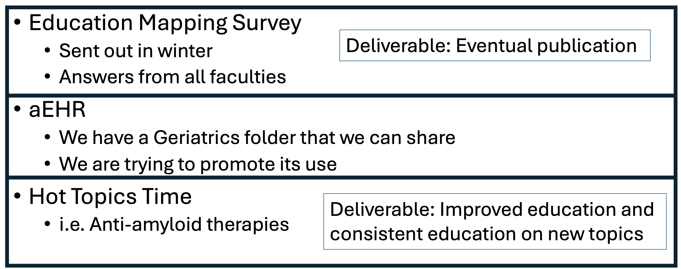
GERIATRICS SIG
Projects currently under way and expected deliverables

Slide 16
e-RESOURCES SIG
Lisa Bishop
  Memorial University

Slide 17

e-RESOURCES SIG
Rebranding of the Informatics SIG to the e-Resources SIG to encompass a wider scope
  The e-Resource SIG supports the continued development, implementation, and promotion of the e-Resource to support pharmacy education
  Modules available open-access at www.eLearnHCP.ca
    Informatics (20 modules) – e.g., EHR, Privacy & Confidentiality, Virtual Care, Documentation, Med Rec, EBM
    Health Promotion (6 modules) – e.g., Smoking Cessation, Vaccinology Series
    EDI & Cultural Safety (5 modules) – e.g., EDI & Indigenous Health, 2SLGBTQQIA+ Health, Transgender Health
    Primary Care (4 case-based modules) – e.g., Patient-Centered Care, Shared Decision-Making, Diversity, Continuity of Care

Slide 18
e-RESOURCES SIG
French translation
  25 modules have been translated in French; 10 to be translated in 2026/27 based on discussions with Francophone schools
New modules
    Queering CVD by Pride Rx (2 modules) – Available in June in both languages
    Ideas for new modules:
      AI in Education
      Preceptor Development
      Student experiential rotation preparation
For more information about the e-Resource, contact Marie Rocchi, e-Learning/e-Resource Manager and Developer at marie.rocchi@utoronto.ca
To join the SIG, contact Lisa Bishop at ldbishop@mun.ca

Slide 19
MEDICINAL CHEMISTRY SIG
Ed Krol (absent)
  University of Saskatchewan
Carlos Velasquez
  University of Alberta

Slide 20
MEDICINAL CEHMSTRY SIG
Environmental scan of medicinal chemistry instruction across Canada
  Established core Medicinal Chemistry concepts listed in course syllabus
  Published: doi.org/10.1016/j.cptl.2024.04.011
Scan of integration of medicinal chemistry with therapeutic decision-making
  Published: doi.org/10.1016/j.cptl.2024.102229
Current project: Specifications grading for medicinal chemistry assessment
  Webinar (C. Velazquez-U of Alberta)

Slide 21
PHARMACY EXPERIENTIAL PROGRAM (PEP-C) SIG
Lisa Little
  Memorial University
Jennifer MacDougall
  Dalhousie University

Slide 22
PHARMACY EXPERIENTIAL PROGRAM SIG
Collaboration on best practices for experiential learning with emphasis on student support and assessment, along with preceptor support and development.
2025-26
  Focus on how we can provide preceptor support with practices busier than ever
  Student presentation on how student-to-preceptor feedback processes

Slide 23
PHARMACY EXPERIENTIAL PROGRAM SIG
Topics for exploration and development 2026-27:
  Preceptor development initiatives
  National collaboration on student readiness modules
  Collaboration with e-Resources SIG on the above
  Possible cross-university elective APPE rotations

Slide 24
PLANETARY HEALTH SIG
Robert Pammett
  University of British Columbia

Slide 25
PLANETARY HEALTH SIG
Projects currently underway:
  Development of Educational Outcomes
    Identify, align and advance planetary health–related learning outcomes within pharmacy curricula and AFPC standards
  Choosing Wisely Canada – Pharmacy STARS
Future Projects:
  Development of Educational Content
    Develop, curate, and share planetary health teaching materials, modules, and curricular resources for pharmacy education
  Planetary Health Report Card for Pharmacy expansion

Slide 26
SELF-CARE THERAPEUTICS &
MINOR AILMENTS SIG
Nardine Nakhla
  University of Waterloo
Colleen Inglis
  University of British Columbia

Slide 27
SELF-CARE THERAPEUTICS &
MINOR AILMENTS SIG
National Knowledge Exchange & Collaboration Network
Goal: Foster collaboration and knowledge exchange among Canadian pharmacy programs through regular educational programming and sharing of innovations in self-care and minor ailment education.
Potential outputs:
  2 annual webinars, workshops, or conference sessions
  Annual newsletter or e-bulletin
  Teaching innovation showcases
  Research dissemination and knowledge exchange activities
  Annual needs assessments across member schools
National Guidance for Self-Care & Minor Ailment Education
Goal: Advance evidence-informed approaches to self-care and minor ailment education through collaborative development of national guidance.
Potential outputs:
  Evidence-based guideline, commentary, or position statement
  Curricular recommendations and best practices
  Assessment considerations
  Ongoing review and update cycle informed by partner feedback

Slide 28
SELF-CARE THERAPEUTICS &
MINOR AILMENTS SIG
National Repository of Teaching & Assessment Resources
Goal: Create and maintain a shared repository of educational resources to support self-care and minor ailment teaching across Canadian pharmacy programs.
Potential resources:
  Patient assessment templates and case scenarios
  OTC counselling tools and resources
  OSCE stations and assessment rubrics
  Multiple-choice question bank
  Curricular exemplars and teaching materials
Partner Engagement & Educational Outcomes
Goal: Collaborate with pharmacy schools, professional organizations, regulators, and practice partners to align education with evolving pharmacy practice.
Potential outputs:
  Formal partnerships with key organizations
  Annual needs assessments
  Curricular and experiential enhancements
  Student confidence and competency evaluation
  Resource adoption and impact assessment

Slide 29
SKILLS LAB SIG
Andrea Swanson
  University of Toronto
Mikaela Thorne (incoming Chair)
  Memorial University

Slide 30
LEADERSHIP DEVELOPMENT SIG
Status
  Currently ~75 members from 10 Faculties
Projects currently underway:
  Re-writing our terms of reference
    Circulating a survey to our members to re-evaluate our purpose and align with their needs
  Showcasing our members initiatives
Future Projects:
  Utilizing our survey data to create working groups
  Looking to collaborate with other SIGs

Slide 31
TRUTH & RECONCILIATION SIG
Dana Turcotte
  University of Manitoba
Larry Leung
  University of British Columbia

Slide 32
TRUTH & RECONCILIATION SIG
Current Project: National Examination of Indigenous Health and Cultural Safety Curriculum in Canadian Pharmacy Programs
  Completed with substantial contributions from Safura Ghouse (UBC PharmD 4) and Alina Dhanji (UBC PharmD 4) through a UBC Directed Studies project.
  A 10-year retrospective examining progress since the release of the Truth and Reconciliation Commission Calls to Action in 2015.
  Included program surveys and one-on-one interviews with representatives from Canadian pharmacy programs to identify curricular topics, integration approaches, content hours, teaching and assessment methods, and program-identified priorities for the future.
  Manuscript has been completed and submitted to CPJ for consideration.

Slide 33
TRUTH & RECONCILIATION SIG
Being considered:
Development of a National Framework/Guideline for Indigenous Health and Cultural Safety in Pharmacy Education
  Goal: Develop a consensus-based framework/guideline, in partnership with Indigenous educators, Elders, Knowledge Keepers, students, and community partners, to support pharmacy programs in meeting and exceeding CCAPP accreditation standards.
  Potential outputs: core principles, recommended curricular components, minimum content standards, and assessment considerations.
Creation of a National Repository of Teaching and Assessment Resources.
  Goal: Create a shared repository of Indigenous health and cultural safety educational resources for pharmacy educators and programs across Canada.
  Potential resources: cases, OSCE scenarios, skills lab activities, reflection assignments, assessment rubrics, Indigenous-created teaching materials, resources on Indigenous pedagogies for faculty, and curricular exemplars from pharmacy programs across Canada.

Slide 34
SUBSTANCE USE & HEALTH SIG
Michael Beazely (absent)
  University of Waterloo
Essi Salokangas
  University of Alberta

Slide 35
SUBSTANCE USE & HEALTH SIG
Projects underway and expected deliverables:
  The Substance Use and Health SIG represents a revitalization and adaptation of the former Opioid Working Group
  Our aim is to support pharmacy education and practice related to substance use, with a focus on:
    Helping programs address current and emerging curriculum requirements;
    Serving as a national resource for educators and pharmacy faculties; and
    Fostering collaboration and knowledge-sharing among members.
  A revised TOR was submitted to AFPC in February 2026 to formally establish the updated SIG

Slide 36
SUBSTANCE USE & HEALTH SIG
Future Projects to Share
  Our first official meeting will take place today at CPERC 2026 - anyone is welcome!
    An opportunity for current and new members to connect, discuss priorities, and identify future projects and goals.
  We are open to collaboration with other SIGs where there is overlap in mandate, mission, or shared areas of interest.

Slide 37
INFECTIOUS DISEASES SIG
Brett Barrett
  University of Waterloo
Nathan Beahm
  University of Alberta

Slide 38
INFECTIOUS DISEASES SIG
SIG established in2025:
  almost all schools currently represented
First meetings, Terms of Reference completed
Ongoing projects:
  Development of guidance document for what ID-related topics should be covered in Canadian pharmacy school curricula
  Survey being developed to inform this, modified Delphi process

Slide 39
LEADERSHIP DEVELOPMENT SIG
Patricia Gerber
  University of British Columbia
Tatiana Makhinova
  University of Alberta

Slide 40
LEADERSHIP DEVELOPMENT SIG
Informal discussions 2022-2025:
  “Leader” and “Manager” currently tied together in the EOs; interest in focusing on SLD
Formally struck as SIG in 2025
  21 members
    Canadian schools of pharmacy (10/11); University of Minnesota College of Pharmacy
    Co-Chairs: Dr. Patricia Gerber (UBC) and Dr. Tatiana Makhinova (U Alberta)
Key Objectives:
  Inform (not prescribe) national standards for SLD in Canadian PharmD programs
  Develop a White Paper to help guide SLD, for programs to consult while retaining full flexibility in adoption and implementation

Slide 41
LEADERSHIP DEVELOPMENT SIG
Deliverable:
  White Paper = framework to inform and support leadership teaching & learning, curriculum development/renewal: guiding principles for SLD, contemporary definitions of “leader” and “leadership”, leadership competencies at graduation, suggested SLD teaching & learning activities
  May be used by the AFPC Education Committee to help inform the work of revisiting the Educational Outcomes: will not replace nor dictate how the newly struck Education Committee proceeds with the revision of the EOs; nor imply the eventual “look & feel” of the EOs
Progress to date:
  Draft definitions of leadership, attributes & behaviours of a leader, draft leadership competencies
  Solicited feedback from across programs: received individual and group responses
Next steps:
  Provide details and gather further feedback today at the 10:45-11:25 Concurrent Session
  Fall 2026: embark on the development of the White Paper

Slide 42
PHARMACY PRACTICE
GRADUATE EDUCATION SIG
(in development)
Beth Sproule
  University of Toronto
Lee Dupuis
  University of Toronto

Slide 43
PHARMACY PRACTICE GRADUATE EDUCATION SIG
(in development)
This AFPC SIG will support a national discussion and facilitate consensus on advanced pharmacy practice graduate education in Canada.
  Develop a shared understanding of the definition of advanced pharmacy practice in Canada.
  Establish a framework and key considerations for advanced practice graduate degree programs in Canada.
  develop an inventory of advanced practice graduate degree programs in Canada and elsewhere.
  Currently 12 members from 8 Faculties

Slide 44
PROFESSIONAL IDENTITY
FORMATION SIG
(in development)
Jill Hall
  University of Alberta
Natalie Kennie-Kaulbach
  Dalhousie University

Slide 45
PROFESSIONAL IDENTITY FORMATION SIG
Status:
  Formed as informal group in Oct 22, with representation from each faculty.
  Meet monthly to discuss projects & new literature, share instructional approaches, and brainstorm ideas.
  Members have presented various PIF related content at CPERC over the past 4 years

Slide 46
PROFESSIONAL IDENTITY FORMATION SIG
Projects currently underway:
  Environmental scan of approaches to PIF at each Canadian pharmacy school completed, submitted for publication.
  Beginning work on a curricular framework for supporting professional identity formation across the PharmD program.
  Creating a hub with resources (theory, activities, reflections) for use by instructors for student engagement.
  Collating faculty development resources.

Slide 47
SOCIAL HEALTH SIG
(in development)
Tiffany Lee
  Memorial University
Tarek Hussein
  University of Toronto

Slide 48
SOCIAL HEALTH SIG
Purpose:
  The AFPC Social Health SIG focuses on, promotes, and assists in addressing key issues related to the social dimensions of health and well-being in Canadian pharmacy education, including structural competency, social determinants of health (SDH), and social prescribing. The SIG assists pharmacy programs in meeting current and future curricular requirements for graduates to identify SDH and integrate social prescribing into pharmacy practice, in alignment with the 2025 Pharmacists’ Patient Care Process (PPCP)1 and emerging national educational outcomes.
Goal:
  Through educational standardization, the SIG supports the longer-term transformation of pharmacy graduates into providers of socially responsive care by:
    Contributing expertise in social health pharmacy education and serving as a national resource for educators and pharmacy faculties across Canada; and
    Supporting programs in their efforts to prepare graduates to recognize and address the non-medical drivers of health within their scope of practice.

Slide 49
PHARMACY PRACTICE RESEARCH SIG
(in development)
A SIG or a Network?
First symposium tomorrow with a session on defining the future of PPR in Canada

Slide 50
AGENDA
Opening Remarks / Introductions
SIG Presentations & Discussions
2nd SIG Summit

